Slide 1

Exploratory Data Analysis
XYZ G2M STRATEGY
20-Sep-2022

Slide 2

Agenda
Executive Summary
Problem Statement
Approach
EDA
EDA Summary
Recommendations

Slide 3
EXECUTIVE SUMMARY
XYZ is a reputable firm in the United States looking to make an investment in the cab industry due to its remarkable growth in the last few years.

Slide 4
PROBLEM STATEMENT
Investigating the various factors that influence the cab industry and derive actionable insights to identify the right company to invest in.
The analysis of the provided data should provide insights into:
What we can understand about cab services from the provided data
What the demand for cab services is at the time period and its predicted demand in the future
What company has and retains the most users

Slide 5
APPROACH
The provided csv files are loaded in pandas so we can perform exploratory analysis on the data.
We import the given files and convert them to data frames, merge them on common features in each other and export the resulting data frame into a final csv file.
Cab_data
City
Customer_id
Transaction_id
Final data

Slide 6
EXPLORATORY DATA ANALYSIS
We change the data types of features such as users and population and clean the dataset so we can properly explore the data given.
We note that there are no null values in the dataset and minimal outliers that we will retain as price charged is correspondent to distance but there may be additional variables not contained that affect the pricing.

Slide 7
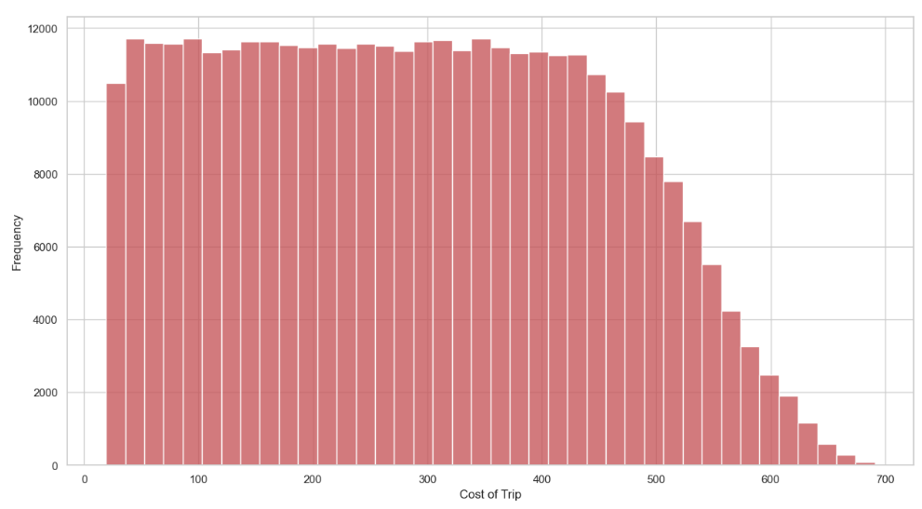
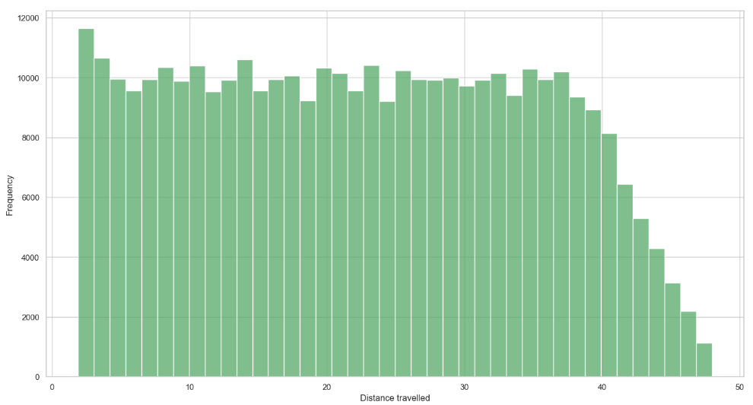
Data Understanding
We visualize some of the data to see any correlations or matches with our research and we can see that the frequency of transactions higher distances and higher trip prices are less

Slide 8
Data Understanding
From this, we can see that the cabs mostly serve commercial purposes and can be accessed for many service ranges which are factors we’ll be looking into when making our investment

Slide 9
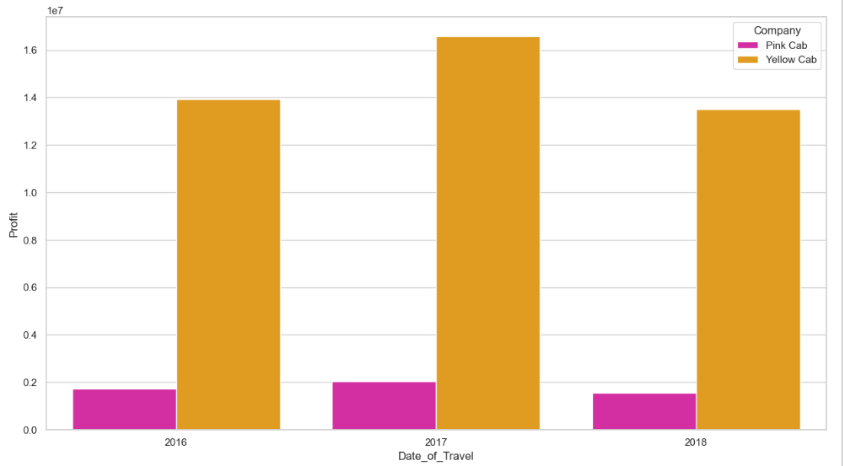
Profit Analysis
Yellow cab makes significantly more profit than the pink cab on a yearly basis with 2017 being the most profitable year

Slide 10
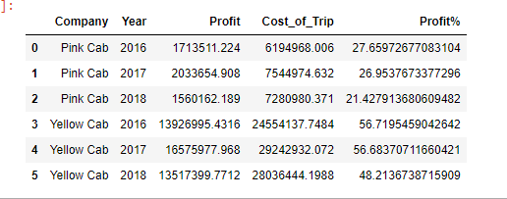
Profit Analysis
The yearly percentage profit made by yellow cab in 2016 and 2017 amounted to about 56% of their operating cost
For pink cab in the same time period, the percentage profit was 26% and 27% of their operating cost for both years respectively

Slide 11
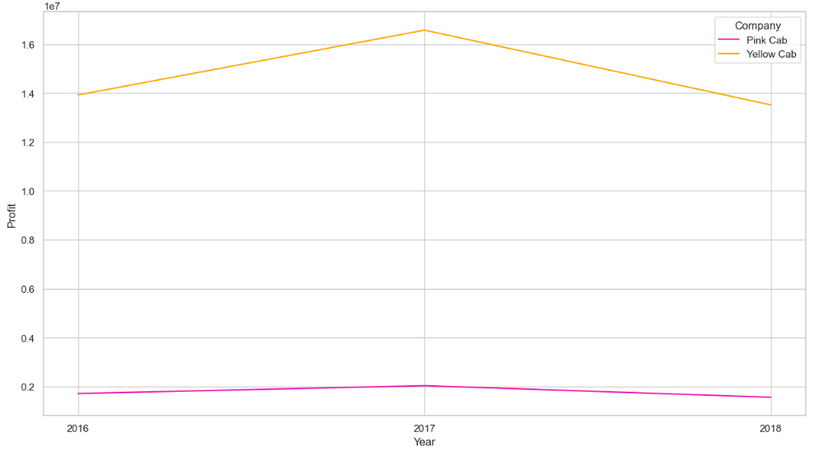
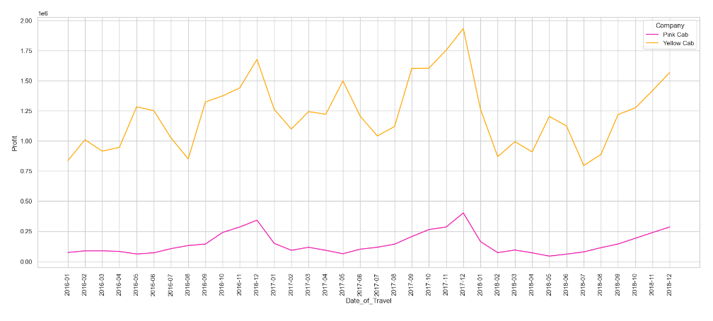
Monthly and Yearly profit over time

Slide 12
Monthly and Yearly profit over time
We see some seasonality in the data over the monthly profit as there is a common spike in the data towards the year end. This may be attributed to more rides at that period for the holidays.

Slide 13
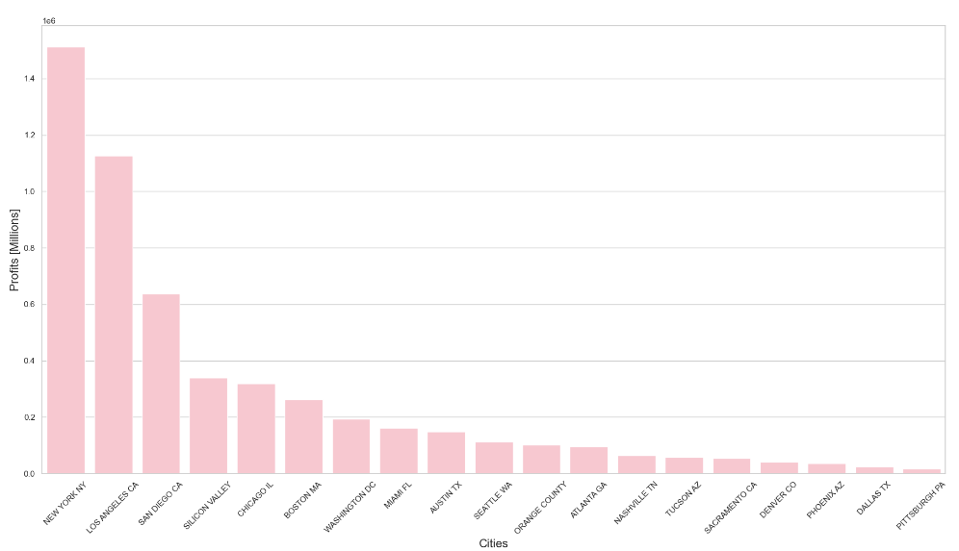
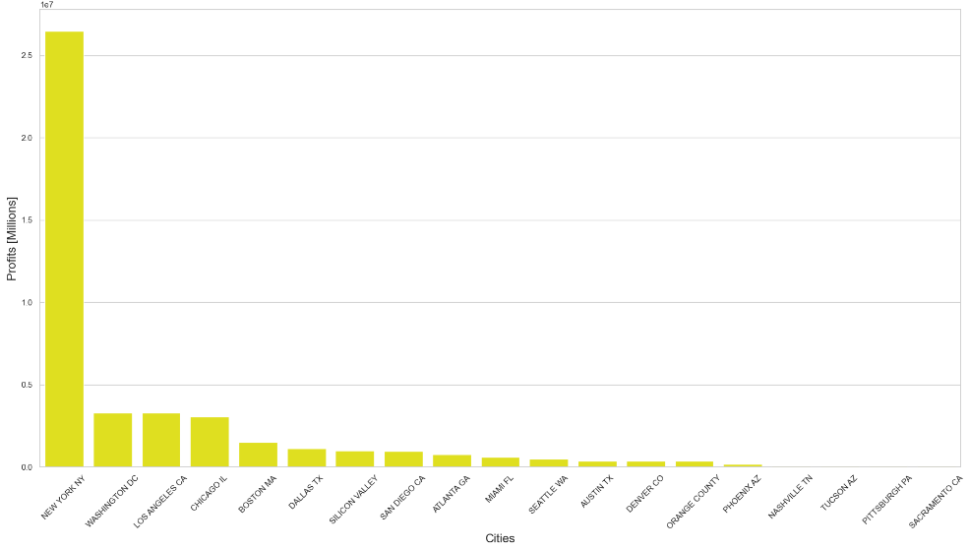
Profit by City

Slide 14
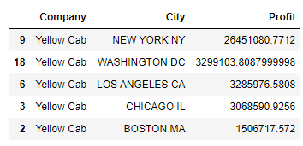
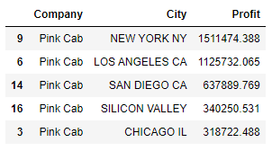
Profit by City
The previous graphs display the total amount of profit made in each city showing a major difference between New York and all other states. The difference with other states compared to New York was by a wider margin for the yellow cab than the pink cab however
The yellow cab maintains a higher profit margin compared to the pink cab overall in all states

Slide 15
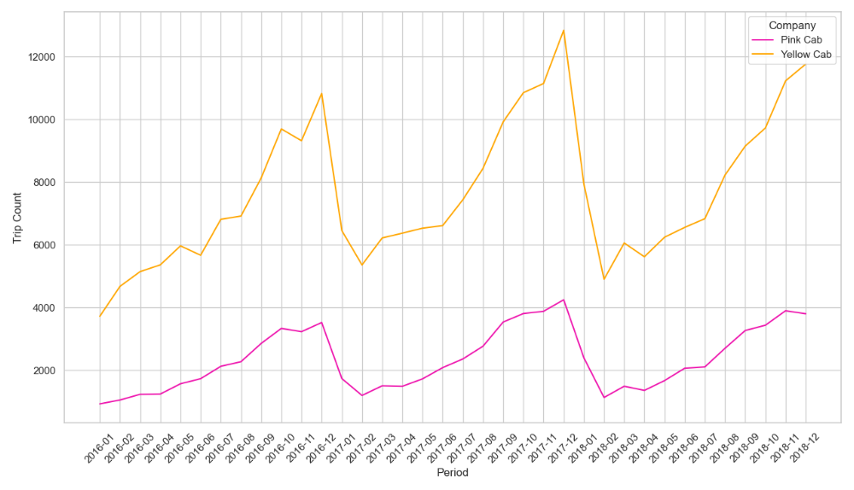
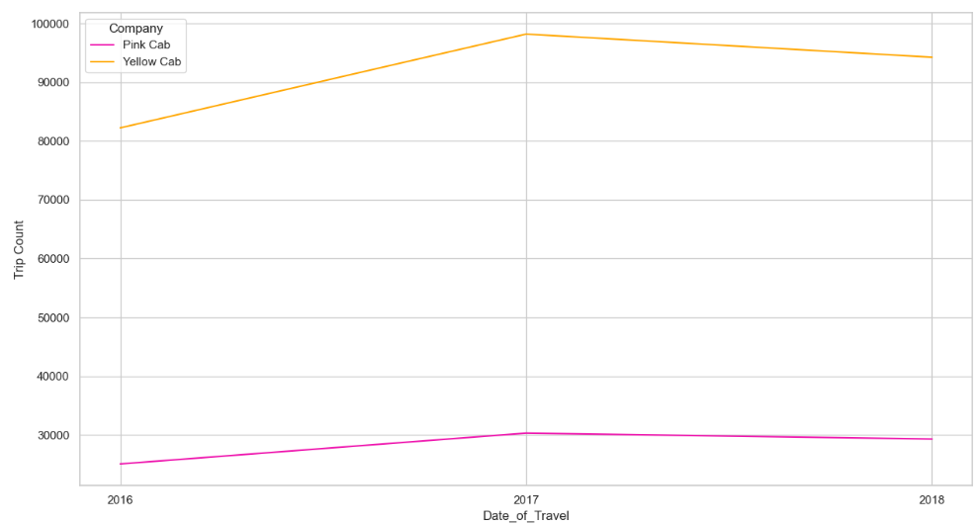
Customer Analysis and Demand

Slide 16
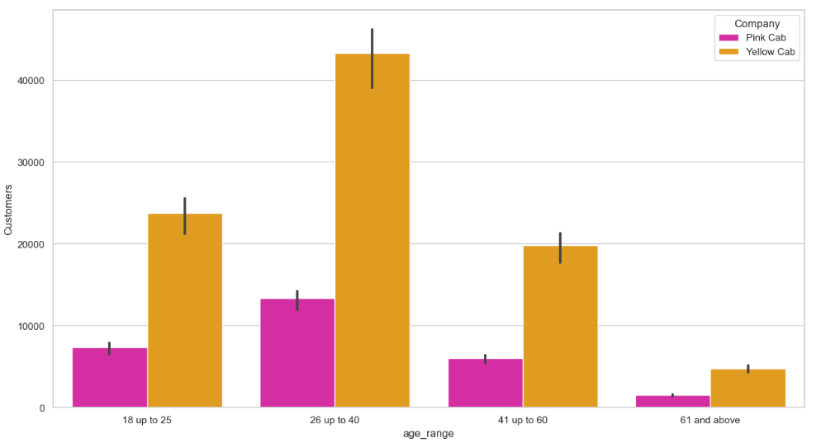
Customer Analysis
The plot shows the count of users for both companies.

Slide 17
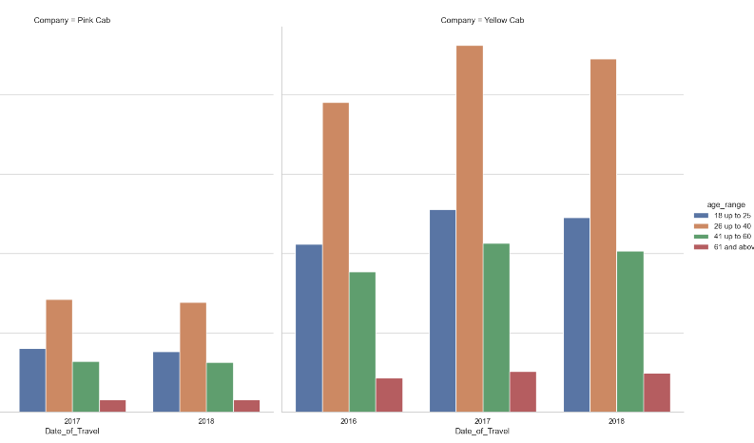
Demand by age group
The number of trips taken by customers relative to each company shows a preference for the yellow cab company by all ages

Slide 18
Demand by age group
The 26 to 40 age range is the most dominant user of both cab services which shows a requirement for transport services majorly at that age.
We also see a similar trend as the profit analysis towards the end of each year with more customers trips being taken at this period

Slide 19
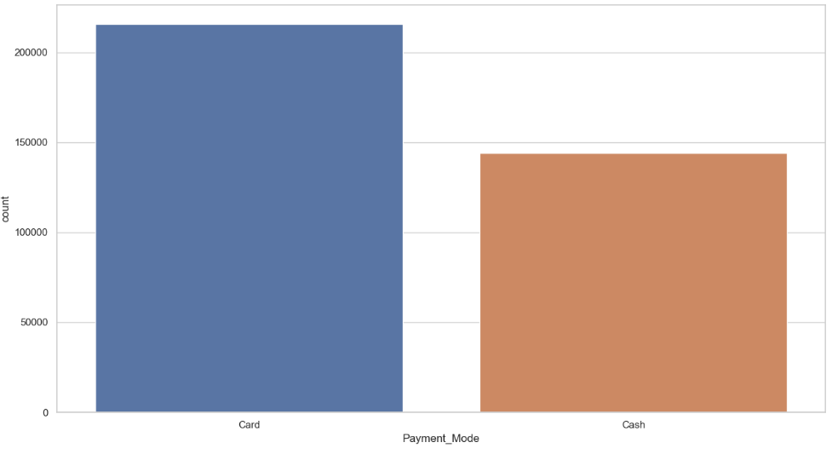
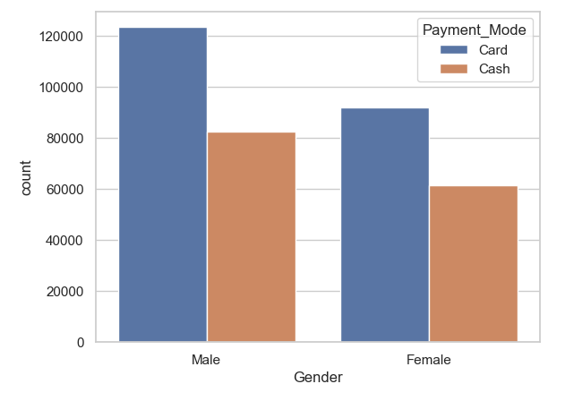
Payment Method Analysis
The dominant method of payment is by card and the charts also show that this is the preferred method chosen by both male and female users

Slide 20
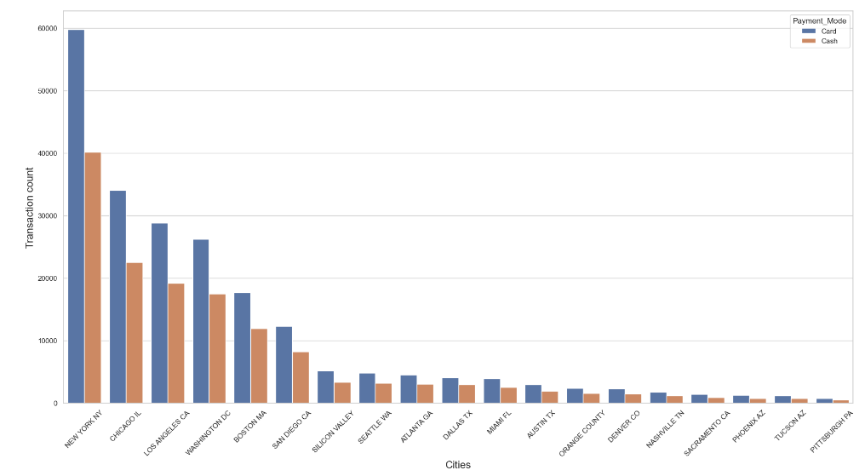
Payment Method Analysis
We see how dominant card payments are for the companies state wise too as it remains so through all states

Slide 21
FORECAST
We plot a trend line for the months in the data showing the profit made so far and the estimated profit for the incoming year. We use the months so we can get a better view of trends predict properly.

Slide 22
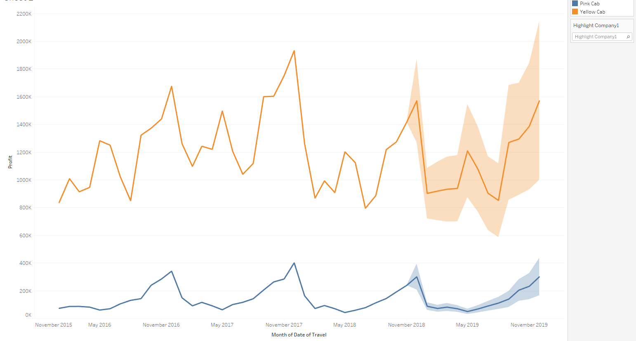
Monthly forecast
The predicted profit shows a similar trend to the previous year for both the pink and yellow cab companies with a slight difference in the middle of the year. The seasonal uptrend at the end of the year maintains its course.

Slide 23
EDA SUMMARY
We gained the following insights from the analysis:
Customers – Yellow cab maintains a large share of customers and although they have a higher profit margin which can be seen from higher prices charged, they are able to maintain a bulk of the market share
Demand – Although they both maintain similar demand over the given periods, Yellow cab maintains a higher demand rate than pink cab by state and with all age groups in numbers
Payment Distribution – Both companies maintain similar distribution of the payment mode used with respect to their counts and this likely has a minimal effect on retaining users.
Profit – Yellow cab maintains a higher profit margin through all factors analyzed.

Slide 24
RECOMMENDATION
On the basis of the analysis, we recommend the yellow cab company for investing as we can expect a return on XYZ’s investment and profitability in record time

Slide 25
Thank You

